Slide 1
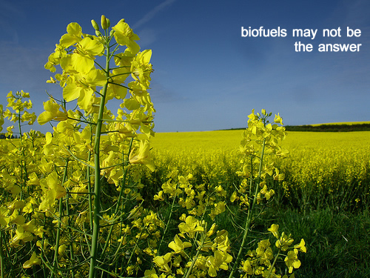
Production of biofuels in AT & CZ and its impact on the food market
Nora Kandler
Marta Gryčová

Slide 2
Outline
1. Introduction to the issue
II. Ist and 2nd generation of biofuels – pros and cons
III. Food crisis
IV. Biofuels in Austria
V. Biofuels in the Czech Republic
VI. Analysis of the relation between the production of biofuels and food prices
VII. Discussion of results and future perspectives

Slide 3
I. Introduction to the issue

Slide 4
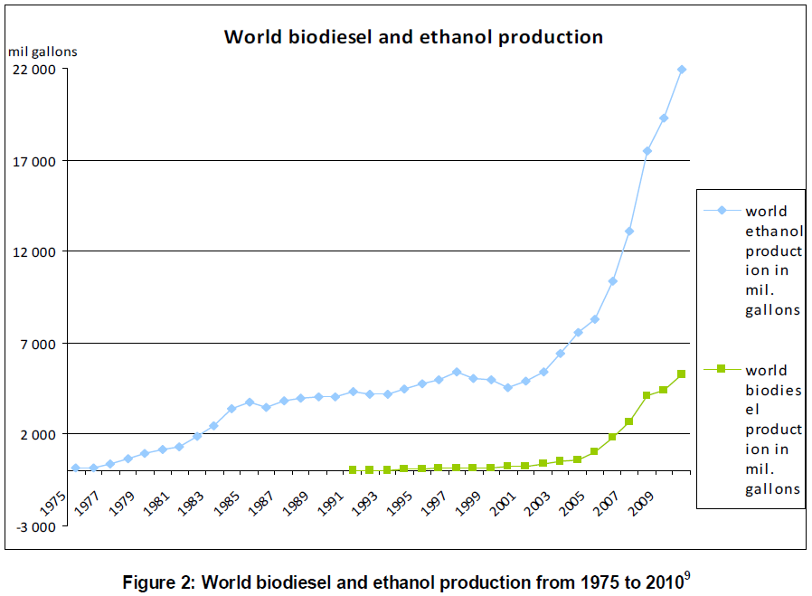
I. Introduction to the issue
Global production of biofuels
annual growth rate of 6% and 5% for biodiesel and bioethanol production resp.,
4.4 billion gallons for biodiesel and 19.3 billion gallons for bioethanol in 2009
Consumption of biofuels – only 2% of world fuels consumption in 2008 (UNEP)

Slide 5
I. Introduction to the issue

Slide 6
II. 1st and 2nd generation of biofuels
1st generation
  biofuels that are produced from plants that contain sugar, starch or oil, such as corn, wheat, barley, sugar cane, rape seed, soybean, sunflower or from animal fats
Advantages | Disadvantages
savings of GHG and other air pollutants (x land use effect) | competition with agriculture food production and land use
rural development and employment | intensive agri. production - increased eutrophication of surface water
less dependence on fossil fuels | water pollution and water usage
 | risk of deforestation
 | biodiversity and local ecosystems
 | expensive

Slide 7
II. 1st and 2nd generation of biofuels – pros and cons
Source: Reinhardt GA, von Falkenstein E, (2010): „Environmental assessment of biofuels for transport and the aspects of land use Competition“, Biomass and Bioenergy

Slide 8
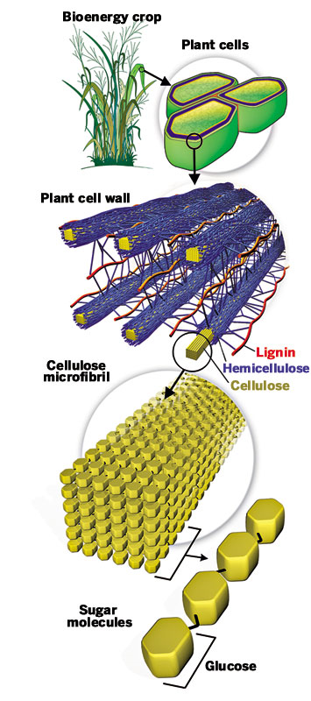
II. 1st and 2nd generation of biofuels – pros and cons
2nd generation
  biofuels produced from
  cellulose, hemicelluloses or lignin

Slide 9
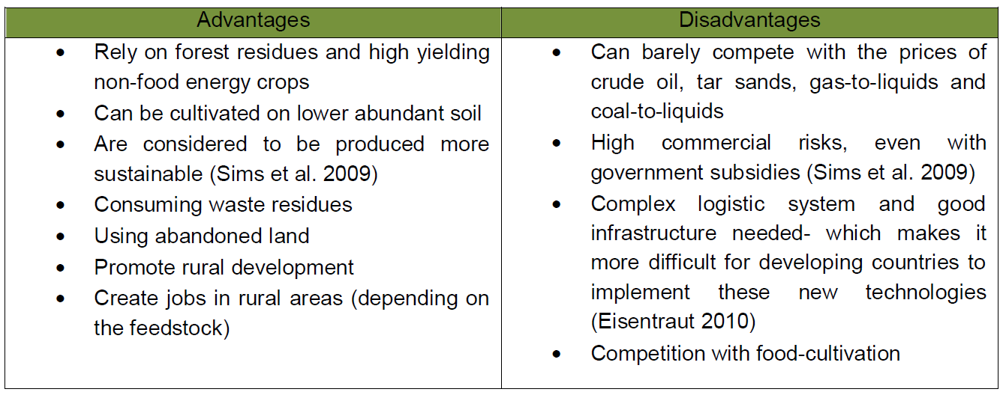
II. 1st and 2nd generation of biofuels – pros and cons
2nd generation
  biofuels produced from cellulose, hemicelluloses or lignin

Slide 10
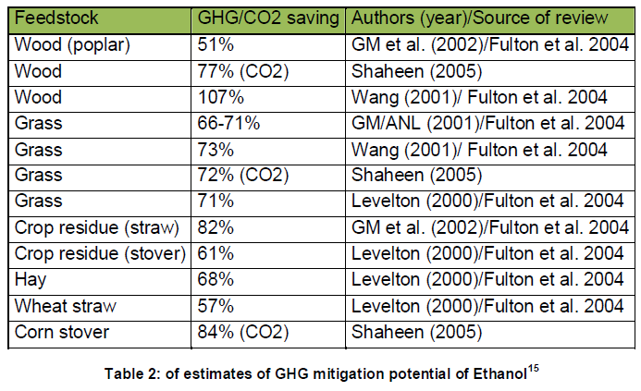
II. 1st and 2nd generation of biofuels – pros and cons

Slide 11
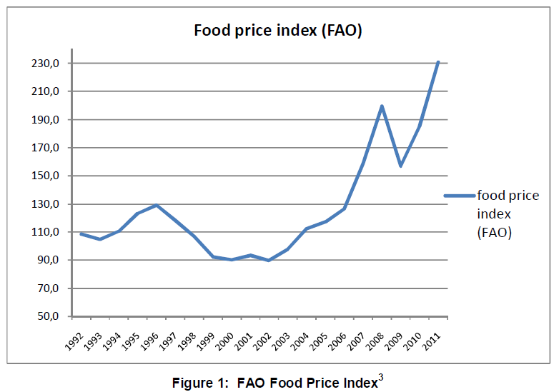
III. Food crisis
2008 - first time the inter-linkages of food and energy were noticed
IMF estimations:
biofuel production responsible for global price increases of 70% for corn and
40% for soy

Slide 12
III. Food crisis

Slide 13
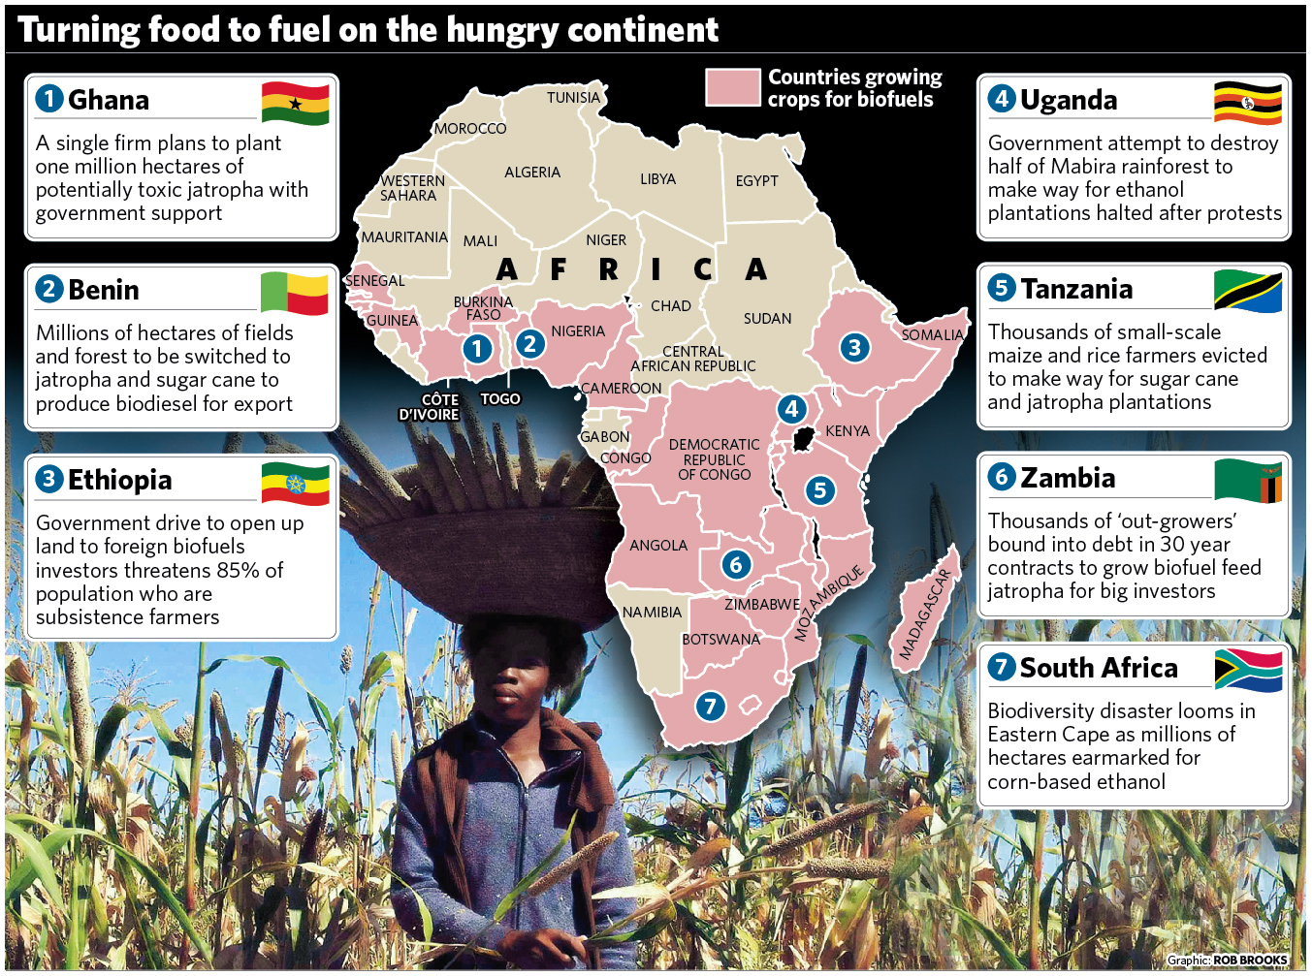

Slide 14
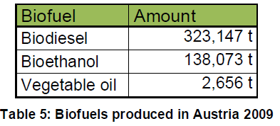
IV. Biofuels in Austria
Number 14 among the top 25 countries producing bioethanol with its 485 mil. liters (128.14 mil. gallons) produced in 2010 and number 16 among the top countries producing biodiesel with its 982.96 mil. liters (259.7 mil. gallons) (Global Biofuels Center)
Biodiesel: 2009 14 utilities were in use. Whole capacity: 650.500 t/a
2011 an increase to 700.000 tonnes was expected. (WKO)
Bioethanol: One bioethanol plant operating in Austria, that was put into operation in 2007. After extension 2009 its capacity is 191.000 t/a. As a by-product: 190.000 t/a of DDGS (Distiller’s Dired Grain with Solubles)
Biogas: In 2010 there were 344 licensed biogas plants in Austria with a capacity of 93.4 MW
2009 – 5.952.125 t of Diesel sold (5,889,649 t or 99%)
blended with 6.52% vol. on average
1,841,863 t of petrol sold (1,841,711 t with a biogenic
content averaging 4.95%

Slide 15
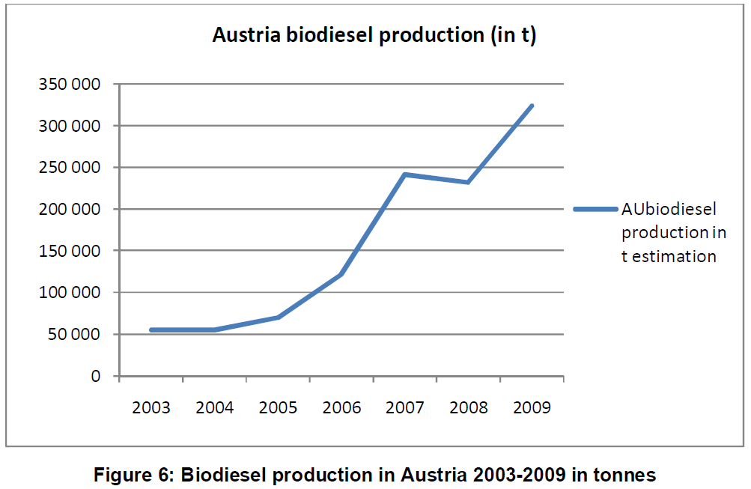
IV. Biofuels in Austria
Not able to produce the necessary amount of feedstock to fulfill the quota. Again importation of biofuels and feedstock (e.g.: rapeseed-seeds, vegetable oil…) from countries like Hungary, Czech Republic, Romania, Bulgaria and possibly Ukraine, would be necessary

Slide 16
V. Biofuels in the Czech Republic
number 22 among the top 25 countries producing bioethanol with its 280 mil. liters (73.98 mil. gallons) and number 25 among the top countries producing biodiesel with its 459.77 mil. liters (121.47 mil. Gallons) (Global Biofuels Center)

Slide 17
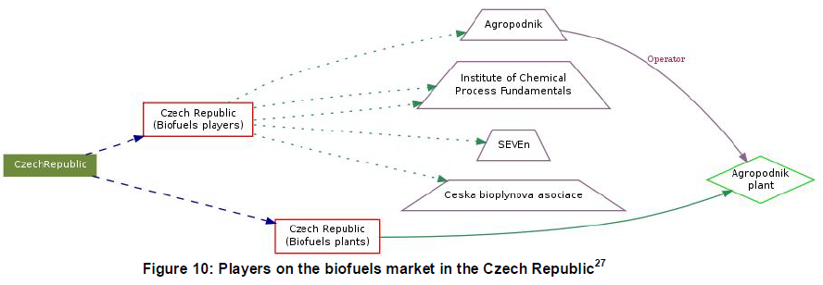
V. Biofuels in the Czech Republic
14 plants producing biodiesel or bioethanol
197,988 tonnes of FAME and 94,523 tonnes of bioethanol in 2010
Firm in Czech Republic | Location
ADW Bio | Krahulov
Agropodnik Domazlice | Domazlice
Agropodnik Jihlava | Polna
BIOPAL | Kolin
Chebio | Karlovy Vary
Chemopetrol | Litvinov
Citronelle
Cukrovary TTD/Tereos | Dobrovice
Ethanol Energy | Vrdy
Jihocesky zemedelsky Lihovar | Blatna
Moravsky Lihovar | Kojetin
PLP | Trmice
PREOL, a.s. | Lovosice
SWP Trading | Horni Sucha

Slide 18
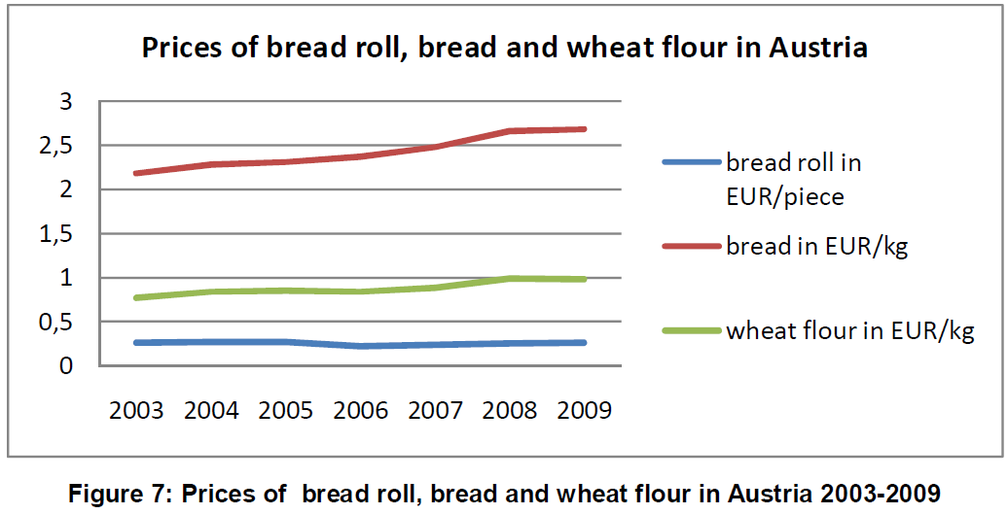
VI. Analysis of the relation between the production of biofuels and food prices
P(bread) = a₁ UV + a₂X + u_{t}
  where P(bread) is the price of bread (or bread roll and wheat flour)
  X is the production of biofuels in tonnes,
  UV is a unit vector and
  u_{t} is a stochastic variable (error term)

Slide 19
VI. Analysis of the relation between the production of biofuels and food prices
Austria
  P(barley) = 62.59 + 0.0005541X,
  where P is the price of barley in US dollars per tonne in the Austrian market and X is the production of biodiesel in Austria in tonnes. The parameter 0.0005541 means that an increase in the production of biodiesel of 1 tonne causes an increase of the price of barley by 0.0005541 USD/t.
  In the equation with the price of wheat in USD/t the parameter a₂ was estimated to 0.000673298 and the constant was 67.007.

Slide 20
VI. Analysis of the relation between the production of biofuels and food prices
Other results for Austria:
  An increase in the production of biogas of 1 m³ causes an increase in the price of barley by 0.245363 USD/t
  An increase in the production of biodiesel by 1 tonne causes an decrease in the price of bread roll of -0.0014 € per piece
  An increase in the biodiesel production by 1 tonne increases the price of bread by 0.004122 € per kilo.
  An increase in the biodiesel production by 1 tonne increases the price of wheat flour by 0.005757 € per kilo
  An increase in the production of biogas of 1 m³ causes an decrease in the price of bread roll of 0.02877 USD per piece
  An increase of the production of biogas of 1 m³ causes an increase in the price of bread of 0.001033 USD per kilo
  An increase in the production of biogas of 1 m³ causes an increase in the price of wheat flour of 0.000399 USD per kilo
  An increase in the production of bioethanol of 1 tonne causes an increase in the price of bread roll of 0.001446 USD per piece
  An increase in the production of bioethanol of 1 tonne causes an increase in the price of bread of 0.00385 USD per kilo
  An increase in the production of bioethanol of 1 tonne causes an increase in the price of wheat flour of 0.007009 USD per kilo

Slide 21
VI. Analysis of the relation between the production of biofuels and food prices
Czech Republic
P(barley) = 2875.92 + 0.00852748X,
  where P is the price of barley in CZK per tonne in the Czech market and X is the production of biodiesel (FAME) in the Czech Republic in tonnes. The parameter 0.00852748 means that an increase in the production of FAME of 1 tonne causes an increase in the price of barley by 0.00852748 CZK/t.
  In the equation with price of wheat in CZK/t the parameter a₂ was estimated to 0.000364147 and the constant was 105.483 (not statistically significant estimations)

Slide 22
VI. Analysis of the relation between the production of biofuels and food prices
Other results for the Czech Republic:
  An increase in the area of rapeseed of 1 ha causes an increase in the price of barley by 0.00768267 CZK/t
  An increase in the production of biodiesel (FAME) of 1 tonne causes an increase in the price of bread roll of 0.03131 CZK per kilo
  An increase in the FAME production by 1 tonne decreases the price of wheat flour by 0.0126 CZK per kilo
  An increase in the FAME production by 1 tonne increases the price of wheat flour by 0.00010813 CZK per kilo
  An increase in the area of rape of 1 ha causes an increase in the price of bread roll of 0.030277 CZK per kilo
  An increase in the area of rape of 1 ha causes an increase in the price of wheat flour of 0.004324 CZK per kilo
  An an increase in the area of rape of 1 ha causes an increase in the price of wheat flour of 0.000399 USD per kilo
  An increase in the production of bioethanol of 1 tonne causes an decrease in the inflation rate of 0.02568 percentage points
  An increase in the production of biodiesel FAME of 1 tonne causes an decrease in the inflation rate of 0.000212542 percentage point

Slide 23
VI. Analysis of the relation between the production of biofuels and food prices – conclusion of results
The main conclusions from our analysis in Austria:
  Biogas production has the highest influence on the price of bread roll, bread and wheat flour, but mainly on the FAO prices of barley and wheat.
  the production of biodiesel has a very low effect on prices (even negative influence on the price of bread)
  the production of bioethanol also has an effect on prices close to zero.
  Why is the production of biogas so important? Because of the consumption in agriculture?
The main conclusions from our analysis in the Czech Republic:
  Recent monthly data of biofuels production (2006-2010) shows even negative relation to the rate of inflation, but still very close to zero
  FAME production has bigger effect on prices than the area of rape, but both very close to zero and even negative relation between the FAME production and the price of wheat flour.

Slide 24
VII. Discussion of results and future perspectives
little positive relationship between the biofuels production and the food prices, but very close to zero; in some cases - even negative relationship (against our hypothesis)
hard to prove the relationship between the biofuels production and food prices on the available data, short time series
future: 2nd generation biofuels, waste oils, Jatropha-based fuels and algae-based biofuels
“A pullout of fossil fuels can’t be achieved if we don’t think about our mobility needs. It will just replace one unsuitable solution for another. We need to reduce our overall consumption and use of fuels if we want to pursue a sustainable strategy.” (Putzer 2010, p. 85/86)

Slide 25
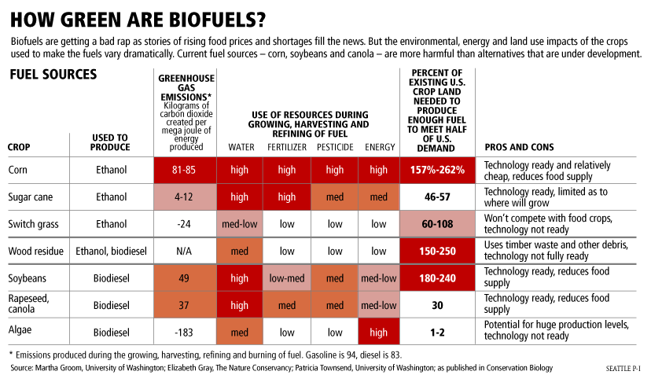
VII. Discussion of results and future perspectives

Slide 26


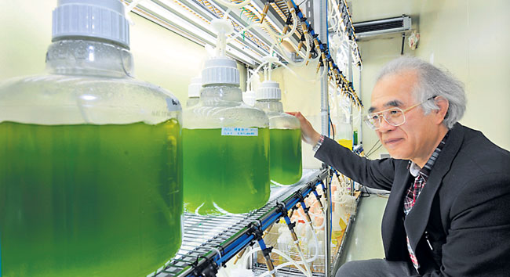


Slide 27
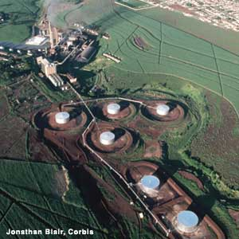
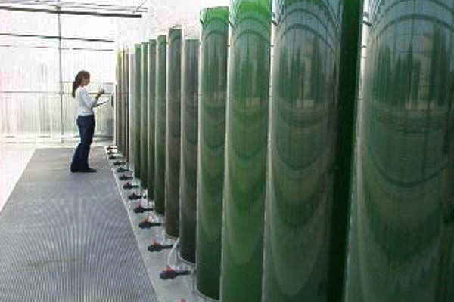

http://www.youtube.com/watch?v=n9_-ZguuhBw&feature=player_embedded
http://www.youtube.com/watch?v=-dBLVtAMn5A&feature=fvw
http://www.youtube.com/watch?v=e-RyKyvWr3I&feature=related
http://www.youtube.com/watch?v=ZoANr2ldzR4&feature=related -good
http://www.youtube.com/watch?v=k4z7p8-4oGo&feature=related
http://www.youtube.com/watch?v=h8KQcWjdhgU&feature=related

Slide 28


Thank you for your attention.

Slide 29
